Slide 1

Using text analytics to develop trading signals
Team Xi:
Beidan Huang, Yilei Wang
Hanxiao Wu, Xipeng Feng
Presentation Date:
2018/12/07
Capstone Project – Supported by the Corporate

Slide 2
Team Responsibilities
Beidan Huang
Team Leader Data Collection, communicate with company SumUp Data extraction and preprocessing
Hanxiao Wu
Build models and run create strategy Perform accuracy test
Yilei Wang
Perform further topic analysis Introduce accuracy and strategies in deep
Xipeng Feng
Run analysis and literature review Compile report and presentation PPT
Using text analytics to develop trading signals

Slide 3
Introduction: Key Issue
Research Question:
The primary interest of this project is to figure out how to leverage Nucleus APIs product to develop an information processing pipeline so as to create trading signals and forecast returns.
Importance:
Most real world data is unstructured data, typically text-heavy and time-consuming, but can contain important information.
Developing a pipeline to help investment professionals to transform text data to trading signals as reference.
Forecasting returns using quantitative method is a trend in financial industry.
Using text analytics to develop trading signals
1

Slide 4
Main Processes
Data Collection & Processing
API Models
Modeling & Strategy
Analysis
Data collection, 10Qs of 100 companies over 10 sectors.
10Q forms and stock prices are core data for us.
Establish datasets and do the data cleaning work.
Run analysis via Nucleus API models.
Several API models will be introduced for text information transforming.
Define indicators and construct model via machine learning methods.
Perform accuracy test for our model.
Create trading strategy based on model and analysis.
Give detailed introduction on topic analysis.
Illustrate accuracy rates of models and the strategy.
Long-short trading strategy suggestion.
Using text analytics to develop trading signals
2

Slide 5
Data and Methods
Data Collection & Processing
Modeling & Strategy
API Models
Analysis
Data
10Q forms
10Q forms
10Q forms
10Q forms
Stock prices
Stock prices
Stock prices
Methods
Nucleus APIs
Nucleus APIs
Nucleus APIs
Nucleus APIs
Crawler
Crawler
Logistic Regression
K-fold Cross Validation
Elastic Net
Grid Search
Using text analytics to develop trading signals
3

Slide 6
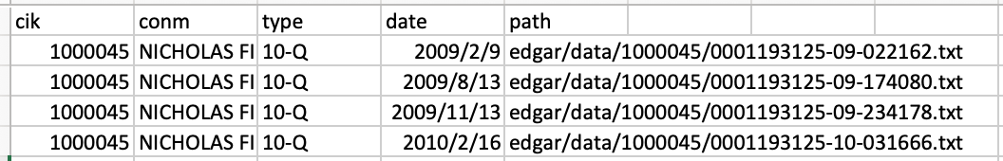
Data Collection & Processing
Step 1: Send Correct Requests to Crawl 10Q filings
Figure 1. Raw material format
100 companies * 3 reports/year * 10 years
Get the detailed
index
Pass the index in URLs to send requests
Using text analytics to develop trading signals
4

Slide 7
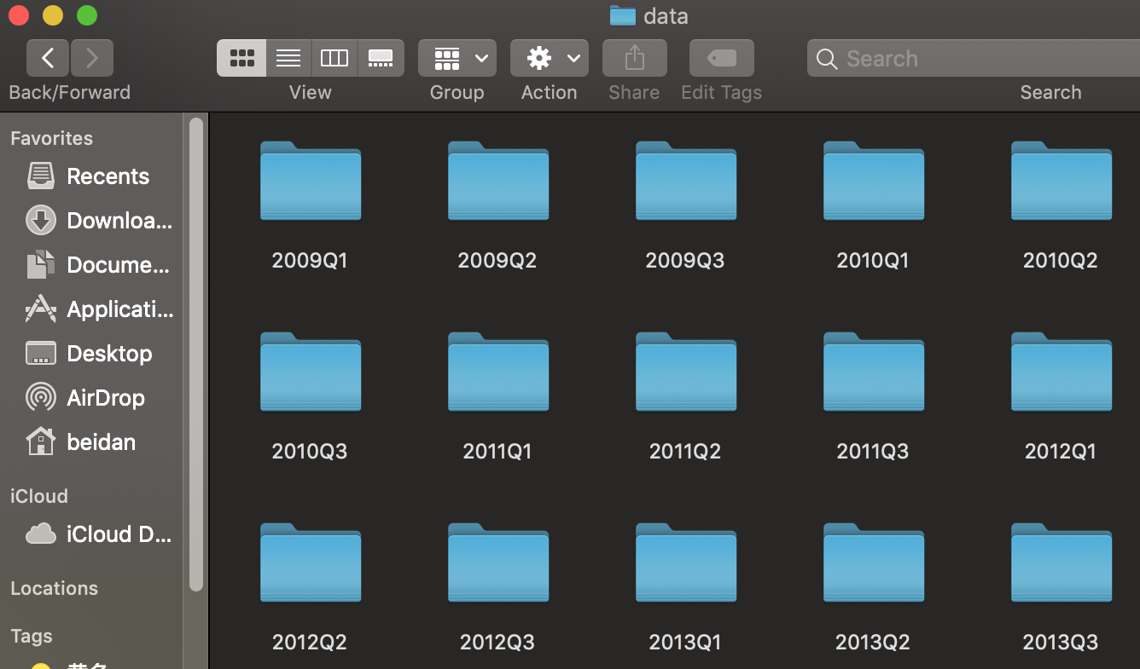
Data Collection & Processing
Step 2: Put Into Right Directory
Figure 2. Datasets established
A single file contains all company reports released in the same account period.
Each company contains three consecutive quarters
Using text analytics to develop trading signals
5

Slide 8
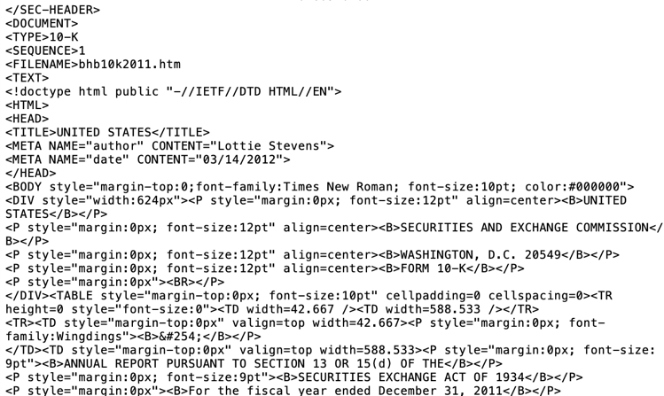
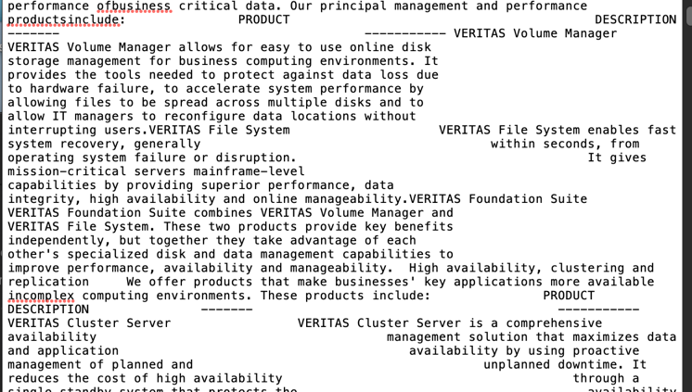
Data Collection & Processing
Step 3: Clean Up to Prepare For Models
Figure 3. Comparison between before cleaning and after cleaning
Before
After
noise
noise
After downloading files, we have to do some data cleaning work to remove irrelevant tags, annotations, images, URLS
Using text analytics to develop trading signals
6

Slide 9
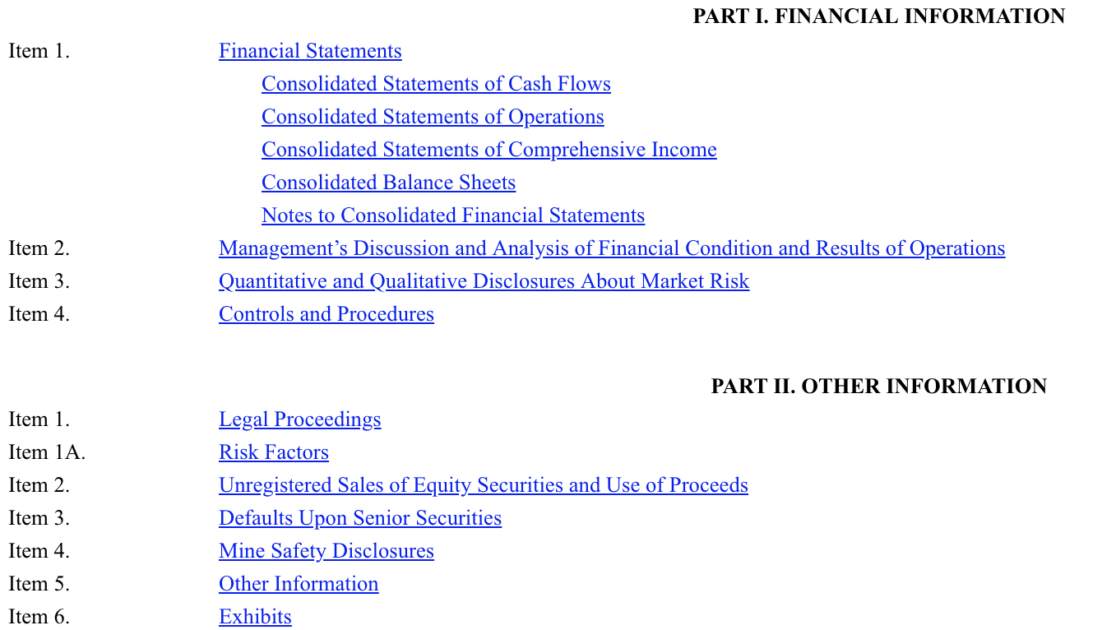
Data Collection & Processing
Step 3: Clean Up to Prepare For Models
Figure 4. ITEMs and content of a quarterly report in SEC
Skip ITEM 1: Financial Statements, ITEM 6: Exhibits
Using text analytics to develop trading signals
7

Slide 10
API Modelling
Information Pipelines to Detect Trading Signals
Analytics:
Topic modeling
Summarization, Sentiment Analysis, Consensus Analysis, Content Recommendation, Historical analysis, Topic Exposure
Data Management:
Dataset Creation
Retrieval of documents metadata
Document display
Using text analytics to develop trading signals
8

Slide 11
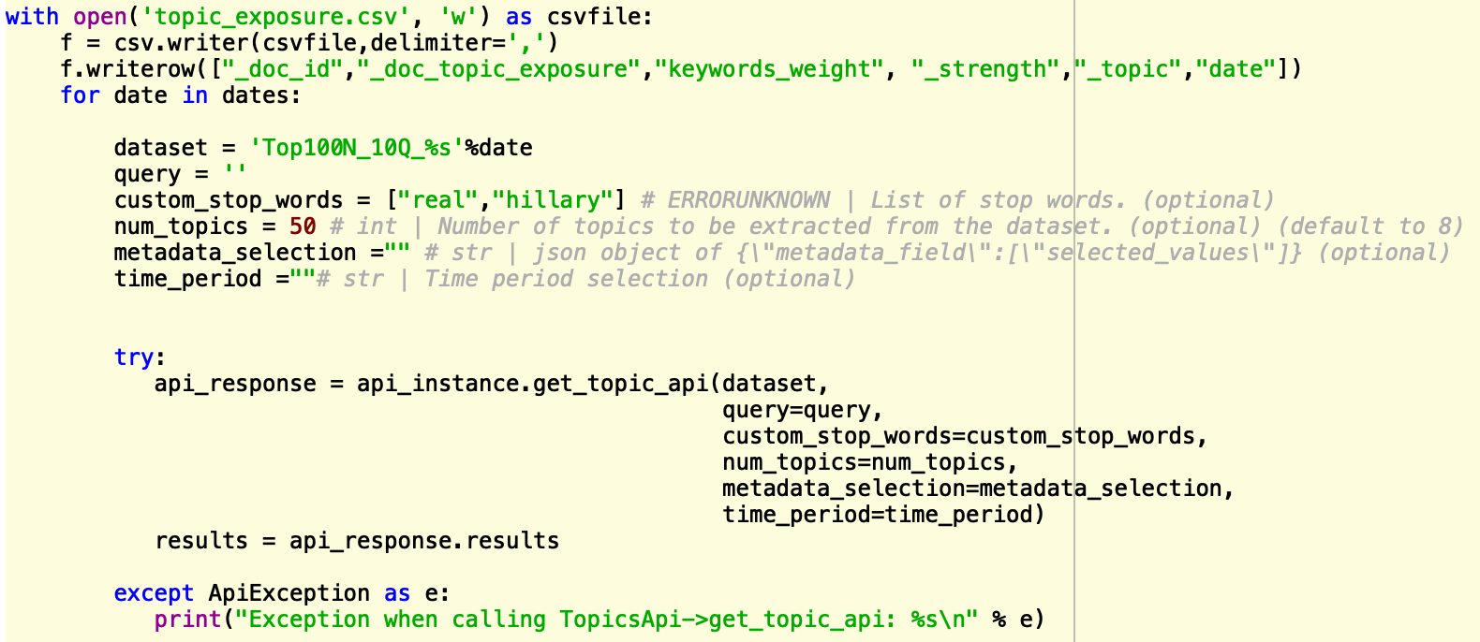
API Modelling
Interaction Page: Take a topic model for example
Figure 5. An API sample pipeline
Set parameters
Here, we take get_topic_api as example for illustration of API modelling.
Here, we take get_topic_api as example for illustration of API modelling.
Using text analytics to develop trading signals
9

Slide 12
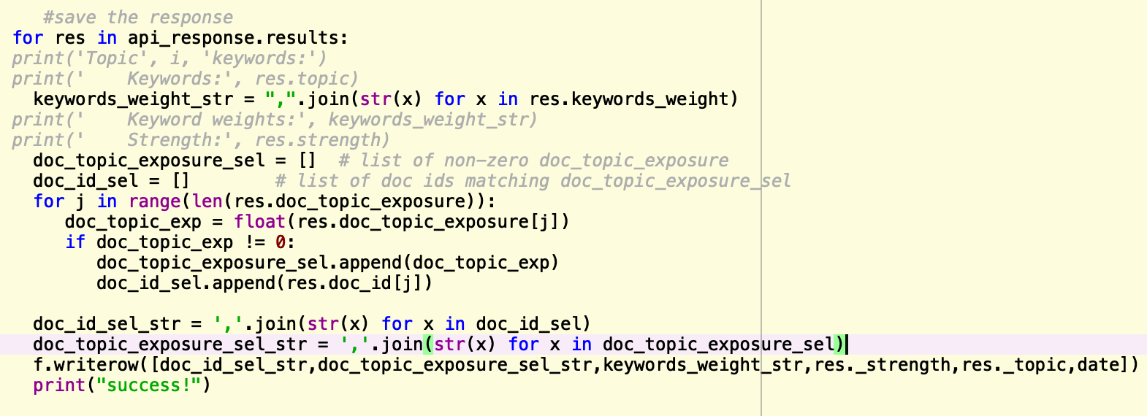
API Modelling
Interaction Page: Save the response to the format we want and write to local disks
Figure 6. Save response and write to local disks
Using text analytics to develop trading signals
10

Slide 13
Modelling and Strategy
Pre-modelling: Indicator definition
Independent Variables:
delta(△) = exposure_{t} – exposure_{t-1}
Dependent Variables:
return = (stock price_{t})/(stock price_{t-1}) – 1
Instead of looking at the return itself, we will focus on direction of the return across quarters; in other words, the magnitude of the return is ignored.
Using text analytics to develop trading signals
11

Slide 14
Modelling and Strategy
Model Construction: Logistic Regression
Figure 7. Comparison between Linear Regression and Logistic Regression
 | Linear regression | Logistic regression
Continuous output | Yes | No, just limited value
Modelled line shape | Straight line | S-curve
The independent variable | Could be correlated with each other. (Specially in multiple linear regression) | Should not be correlated with each other
Basis | least square estimation | Maximum Likelihood Estimation
Equation | Y = b₀+b₁*X₁+ b₂*X₂+……+ b_{n}*X_{n} | P(y=1) = 1/(1+exp^(b₀+b₁*X₁+ b₂*X₂+……+ b_{n}*X_{n}))
Using text analytics to develop trading signals
12

Slide 15


Modelling and Strategy
Model Construction: Elastic Net
In statistics and, in particular, in the fitting of linear or logistic regression models, the elastic net is a regularized regression method that linearly combines the L1 and L2 penalties of the lasso and ridge methods.
The elastic net method overcomes the limitations of the LASSO (least absolute shrinkage and selection operator) method which uses a penalty function based on:
To overcome potential limitations, the elastic net adds a quadratic part to the penalty (||β||2). The estimates from the elastic net method are defined by:
Using text analytics to develop trading signals
13

Slide 16
Modelling and Strategy
Model Construction: Grid Search & Incorporation
'alpha': [10 ** x for x in range(-6, 1)],
'l1_ratio': [0, 0.05, 0.1, 0.2, 0.3, 0.4, 0.5, 0.6, 0.7, 0.8, 0.9, 0.95, 1]}
Hyper parameters
optimization
Grid
Search
Once hyperparameters optimized, we incorporate the parameters into the logistic regression model.
Incorporation
Running the model
Running the model with the training datasets, and we have coefficients results.
Using text analytics to develop trading signals
14

Slide 17
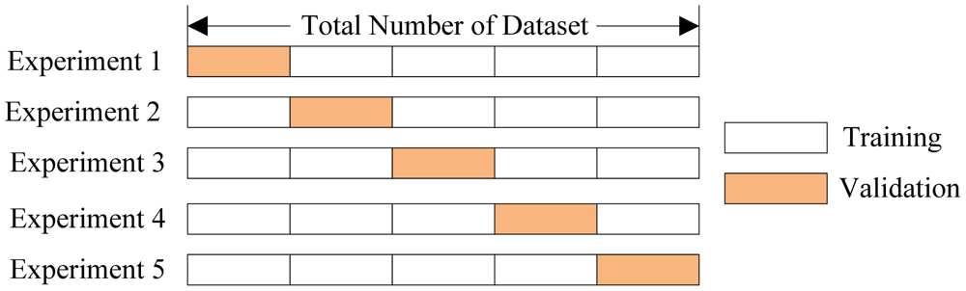

Modelling and Strategy
Accuracy Test: k-fold cross validation
Figure 8. k-fold cross validation for accuracy test
Accuracy Rate:
$$\frac{Number of Correct predictions}{Number of total predictions}$$
Using text analytics to develop trading signals
15

Slide 18
Modelling and Strategy
Trading Strategy
When the new-released 10Q comes in, we can get topic exposures via Nucleus API. Then the classifier will enable us to predict the direction of stock return in the next quarter. Also, the logistic regression will also enable us to retrieve the predicted probability of the positive or negative.
If the output is positive, we assume the price go up and go long on the stock;
If the output is negative, we assume the price go down and short.
* Instead of looking at 100 companies, we concentrate on the samples with potentially confident results – 10 companies which have the highest probability to be positive and 10 companies which have the highest probability to be negative.
Using text analytics to develop trading signals
16

Slide 19
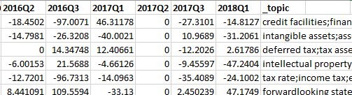
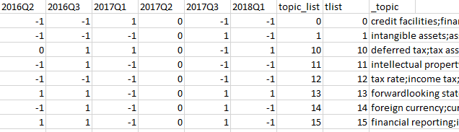
Results and Analysis
Topic Analysis
Figure 9. Beta value of topics over 10-year period
Topic exposure increases means the company talks more about this topic in its 10-Q form.
Figure 10. Sign of beta value of topics over 10-year period
If we are only interested in whether the topic exposure increase has a positive or negative effect on stock returns, we can look at Figure 10.
Using text analytics to develop trading signals
17

Slide 20
Results and Analysis
Topic Analysis Example
Figure 11. Signs of beta of the topic with keywords below
2014Q2 | 2014Q3 | 2015Q1 | 2015Q2 | 2015Q3 | 2016Q1 | 2016Q2 | 2016Q3 | 2017Q1 | 2017Q2 | 2017Q3 | 2018Q1
1 | 1 | 1 | 0 | 0 | 0 | 1 | -1 | 1 | 0 | 0 | 1
Keywords: “research development; development expenses; development activities; development expense; development efforts; development projects; expenses include; will continue”
we can conclude: when 10Q forms contain more information related to research development and development expense, it will have a positive effect on that company’s stock return in next quarter.
We also did some research and proved this conclusion make sense.
Using text analytics to develop trading signals
18

Slide 21
Results and Analysis
Accuracy Analysis
Figure 12. Accuracy rates of models
2009 Q1 | 2009 Q2 | 2009 Q3 | 2010 Q1 | 2010 Q2 | 2010 Q3 | 2011 Q1
0.714286 | 0.769231 | 0.846154 | 0.538462 | 0.923077 | 0.833333 | 0.923077
2011 Q2 | 2011 Q3 | 2012 Q1 | 2012 Q2 | 2012 Q3 | 2013 Q1 | 2013 Q2
0.692308 | 0.384615 | 0.428571 | 0.846154 | 0.785714 | 0.714286 | 0.5
2013 Q3 | 2014 Q1 | 2014 Q2 | 2014 Q3 | 2015 Q1 | 2015 Q2 | 2015 Q3
0.692308 | 0.769231 | 0.642857 | 0.75 | 0.769231 | 0.769231 | 0.615385
2016 Q1 | 2016 Q2 | 2016 Q3 | 2017 Q1 | 2017 Q2 | 2017 Q3 | 2018 Q1
0.583333 | 0.785714 | 0.75 | 0.571429 | 0.857143 | 0.846154 | 0.769231
We ran one regression model for each quarter, and there were 28 models in total. For each model, we used 80% data as training data to build models and 20% data as test data to do accuracy test.
Using text analytics to develop trading signals
19

Slide 22
Results and Analysis
Accuracy Analysis
If predicted Y and true value of Y are both positive or both negative, then our prediction is correct. Otherwise, it is incorrect.
Average accuracy rate = 0.716804
Accuracy rate higher than 50%=0.928571
Accuracy rate higher than 70%=0.642857
Using text analytics to develop trading signals
20

Slide 23
Results and Analysis
Long-short Trading Strategy
Figure 13. Accuracy test results of our strategy
2009 Q1 | 2009 Q2 | 2009 Q3 | 2010 Q1 | 2010 Q2 | 2010 Q3 | 2011 Q1
1 | 1 | 0.85 | 0.8 | 1 | 0.7 | 0.9
2011 Q2 | 2011 Q3 | 2012 Q1 | 2012 Q2 | 2012 Q3 | 2013 Q1 | 2013 Q2
0.6 | 0.4 | 0.3 | 0.9 | 0.9 | 1 | 0.75
2013 Q3 | 2014 Q1 | 2014 Q2 | 2014 Q3 | 2015 Q1 | 2015 Q2 | 2015 Q3
0.95 | 0.75 | 0.8 | 1 | 1 | 0.7 | 0.8
2016 Q1 | 2016 Q2 | 2016 Q3 | 2017 Q1 | 2017 Q2 | 2017 Q3 | 2018 Q1
0.55 | 0.85 | 1 | 1 | 0.65 | 1 | 1
Average accuracy rate = 0.830357
Accuracy rate higher than 50%=0.928571
Accuracy rate higher than 70%=0.821429
Using text analytics to develop trading signals
21

Slide 24
Results and Analysis
Long-short Trading Strategy
For each quarter, we can use our model to generate a score (possibility) to decide if a stock will have positive or negative returns in the next quarter for the stock. We ranked the score and constructed a long-short trading strategy accordingly. Our strategy is as follows:
Long stocks with top 10 score
Short score stocks with bottom 10
Using text analytics to develop trading signals
22

Slide 25
Thanks!

